Slide 1
ETHICS: A VERACIOUS PICTURE
Alex Dore, Alex Westfal, Andy Then
Notes:
https://docs.google.com/document/d/1V6cuacrpuiK1Vh0db71xTCbWfklnGjqXk6ka7HgbaKU/edit?tab=t.0

Slide 2
Ethics: What It Is
Ask yourself what kind of conversations you have with the people around you, and how they differ
Envision yourself at a table with people from different industries. All of them have different ideas on how the economy should be run.
Question types: Science, Economics, Law, Ethics
Next slide will talk about the question types in more detail
Notes:
(Alex) This slide is on the first topics we are introduced to, consisting of the first 10-20 minutes of the lecture. Overview of question types, and maybe a hook on personal preference and autonomy. I am unsure as of now whether I would like to use the Google Glasses example, as it is a bit to similar. Instead, a brief talk about Google glasses, to a translation on Google’s invasive data mining tactics would contrive new ideas in the mind of the audience.
Ethics is like a language

Slide 3
On Question Types
Science: Physical Properties/Material Composition, how much do they weigh? What are they made from (In reference to the electrical engineer’s idea of Google glasses)? What are their dimensions?
Economics: How much do they cost? Will their price change based on the market? How are they incentivising people to buy?
Law: Are these legal? Would the government permit such a tacky thing? Should there be consequences?
Ethics: Is my freedom worth more than your privacy?
Notes:
(Alex) A brief explanation of the question types. At the time of writing, my idea is to talk about the table event in more detail: How might the Economist think? The law student, The Scientist, and so on. This is good on the exploratory sequential (simply put, the form of an idea) on how ideas from in conjunction with people’s preconceived notions.

Slide 4
Ethics: The Language
Ethics is not superficial. It is purposeful, rooted in a specific cause, and based on an individual’s core principles.
The view of ethics is not universal; different ideas for different people
When we discuss if something is “ethical”, that is a discussion of human values, rather than right or wrong, and human values can change based on different factors: location, societal views, etc.
More of a language/dialect than a “truth”
Notes:
(Alex) In this slide, we belabor with a possible tangent on what ethics really means. Our synopsis is that ethics does not have one sole manner of correctness. It is interchangeable; everything we envision is what makes something ethical. Stress that it’s very incorrect to say that ethics determines a right or wong, and talk about persons and ideas with references to politics, societies, and histories of aforementioned societies.

Slide 5
What Ethics Are
Ethics consists of choices we make and justify based on human values (direct quote from lecture)
Ethics is a kind of conversation, a vocabulary
Ethics is not stagnant, it is dynamic. It grows over time and evolves with the people of a society
Ethics provides a moral compass to guide people through complex situations
Notes:
(Alex, end) End w/ While the definition of ethics is clear, it still clashes with other societal measures that we have in place…

Slide 6
Ethical Challenges
When ethics is measured against other societal constructs there is conflict.
Whether it be a privacy concern, a legal matter, or limiting self expression to respect the beliefs/opinions of others, Ethics does not always go hand in hand with these measures, often it contrasts them.
Notes:
In the following slides, we are going to look at how ethics challenge each of these matters, and ask questions that evoke thought while using real life examples to make the hypothetical questions much more real.

Slide 7
Ethics VS Privacy
Privacy means: The right to keep personal information secure and free from unauthorized access. Privacy is important to all of us, and when it is challenged by a public health crisis or new technological innovation, it raises ethical questions.
How do we determine when the need for public safety outweighs privacy
Is it fair for tech companies to track us and all of our data?
What role do we play in safeguarding our own privacy, or is it a right?
Notes:
We can discuss the covid 19 pandemic for public health, the NSA wiretapping & tracking everyone on earth for the technological innovation part, and then for our own role we can talk about the responsibility of the individual nowadays to be aware of how much privacy they are sacrificing.

Slide 8
Ethics VS The Law
While we may think of both ethics and the law as systems to do right, they are not always the same; what is legal is not always ethical and vice-versa. Ethics often drive change in the legal system.
Should people prioritize legal or ethical obligations?
How should society deal with laws that are deemed “unethical”
When is the right time to break the law because of an ethical dilemma ?
Notes:
We can talk about MLK Jr for the question of legal vs ethical: he was breaking the laws of segregation and used ethics to achieve lasting change in the American legal system. For laws that are deemed unethical we can discuss Apartheid in south Africa and should the people follow these laws even though they are unethical. And for the last question/point I am thinking we can discuss another demonstration where people achieved legal change because of an ethical dilemma

Slide 9
Ethics VS Self Expression
The freedom to express one’s self, through beliefs or opinions or art or dance or any other medium, should never be infringed upon. Or should it?
Where is the line between protected expression and harmful speech?
What mechanisms should be in place to manage harmful self expression?
How can we respect others’ beliefs while expressing ourselves?
How does your culture/background influence what is deemed “acceptable” self-expression?
Ethics poses challenges to major systems that we have in place, and forces change. Even so, there are still more ethical dilemmas that we face today.
Notes:
We can discuss the Westboro Baptist Church using offensive language against the LGBTQ community and raise the first question where do we draw the line? For the mechanisms to manage harmful self expression we can talk about moderation on social media, how some sites have their own filters to stop people posting hateful/harmful things and other sites have teams of human moderators who do the same job. For how to respect others beliefs while expressing ourselves we can use the Charlie hebdo example, how it was offensive to the Muslim community but supporters of the magazine claimed it was free speech and it ended in a terrorist attack. And for the final question about how culture affects self expression, I think we can use the hijab debate in France. France has banned all face/head coverings but that is also just part of Islam so two cultures different ethics, dictating what is ok self expression.

Slide 10
Ethical Dilemmas: A Deducing Approach
We’ll evaluate some Ethical situations
The importance of researching your own evidence
Evaluate that some things established in the rule of law may not always be absolute
Ethics evolves insofar that new experiences render old ethics inapplicable. New kinds of experiences dictate many of the present choices
Notes:
Introduction to the dilemmas in the video lecture. We shall briefly gloss over what will be covered in the next slides with new experiences that might render the old ones worthless (Such as a new piece of technology).

Slide 11
Definition of Ethics + Corollaries
How we conceive reality / justify decisions in terms of human values
If there was ever a clear distinction between right and wrong, this class would be futile
Corollary 1: Learning ethics is akin to learning a languages
Corollary 2: Doing ethics is not about selecting right from wrong, so much as producing better and worse evaluations and privileging values
On the surface, it might seem like a strange question, but a more through dive allows us to understand why we might question law/ethics
Notes:
Explanation of the collorarie

Slide 12
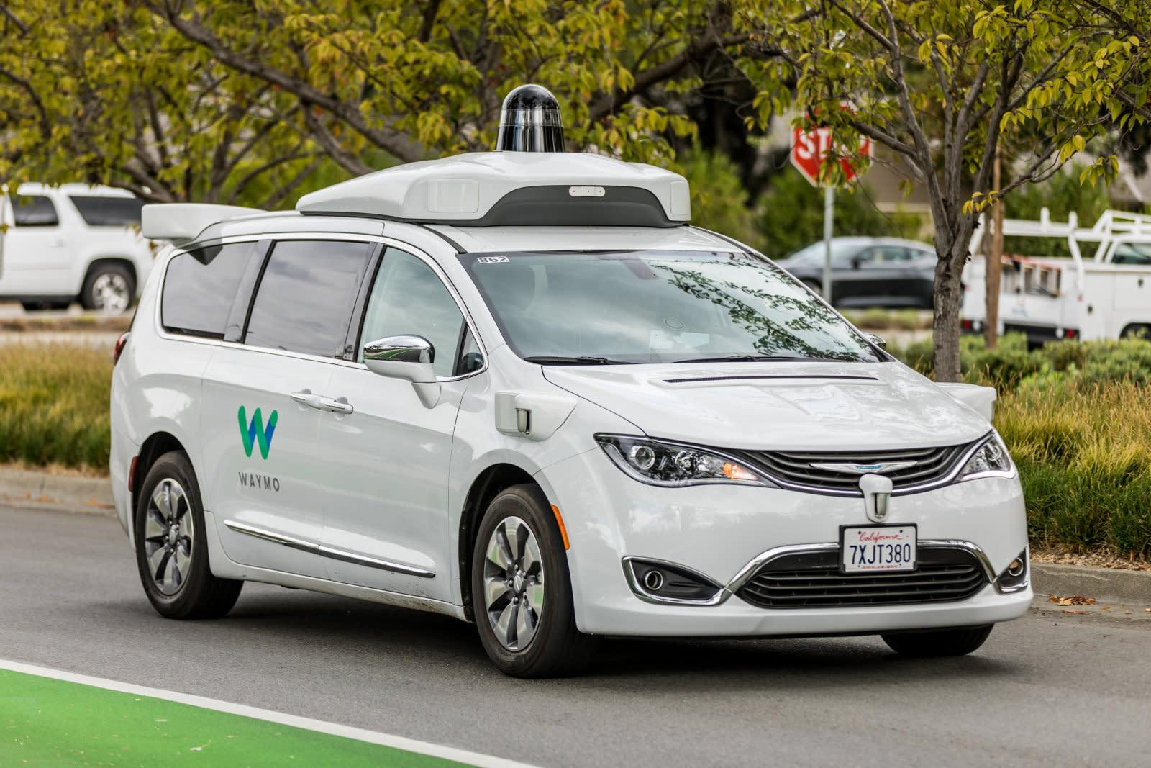
Values And Principles
Too many principles are rigid
Too little misses the mark
Imagine a Waymo: What rules should it abide?
Verdict: Being Flexible and approaching accordingly
Notes:
This is the section consisting of the self-driving car. To approach an ethical dilemma, you must verify your values and principles.

Slide 13
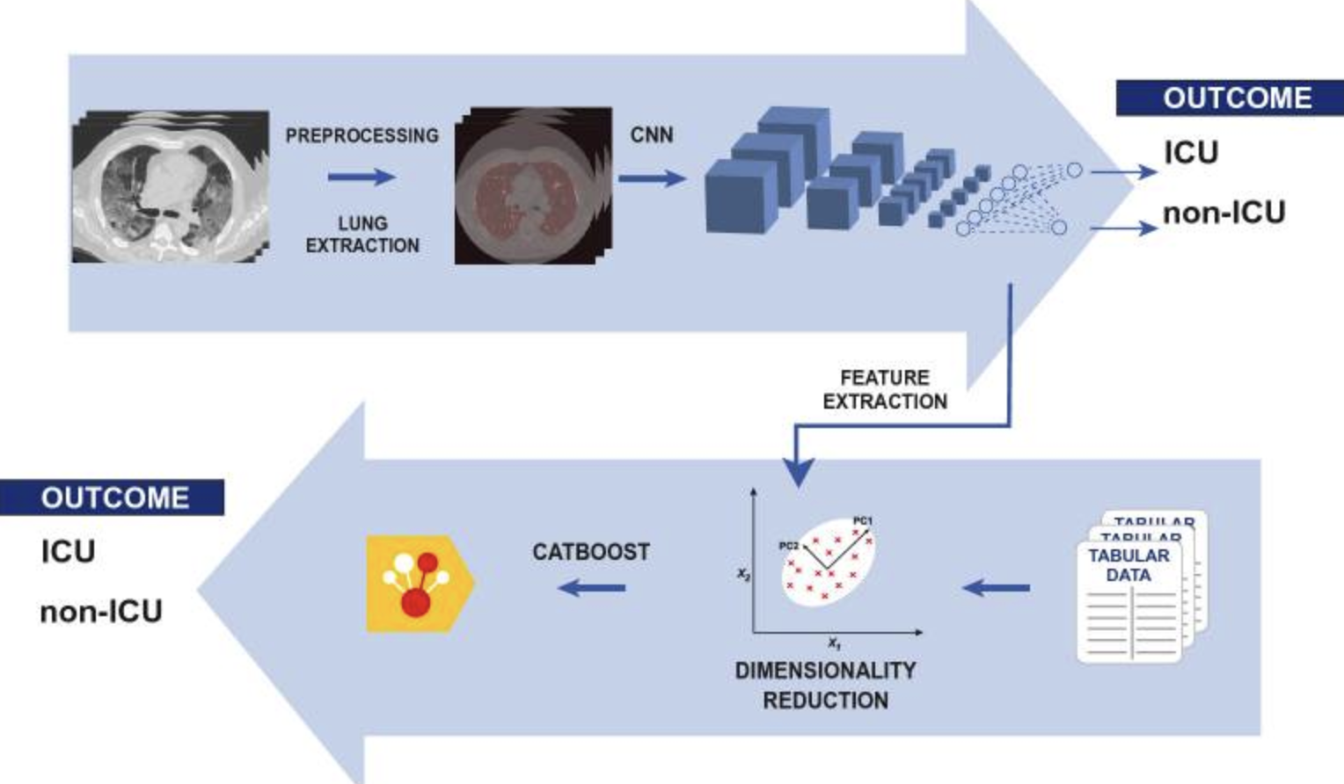
Scenario: Brescia and Patient Confidentiality
1. Height of SARS COVID-19
2. Two AI researchers
3. The Verdict of Italian Courts
Notes:
We shall explain the clear divide between law and ethics. The courts determine that it is not illegal nor legal to use the CT scans as training data. After hearing that, the trio rushed in to train the model. It was a resounding success, saving many lives. After explaining, Ask the audience: Is the law always the greatest good?

Slide 14
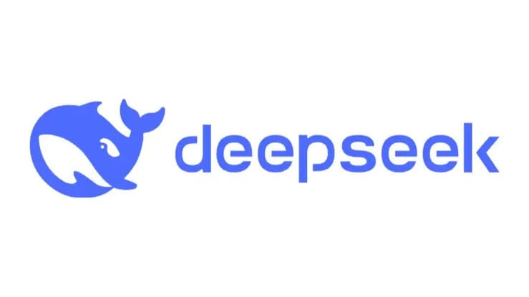

Scenario: ChatGPT versus DeepSeek
Nvidia H100 Versus H800
Extreme Optimization on FP8
DeepSeek Trained on OpenAI’s ChatGPT
Notes:
(Andy will be explaining this slide) This will consist of the ethical dilemmas we see about the LLM wars.

